Slide 1
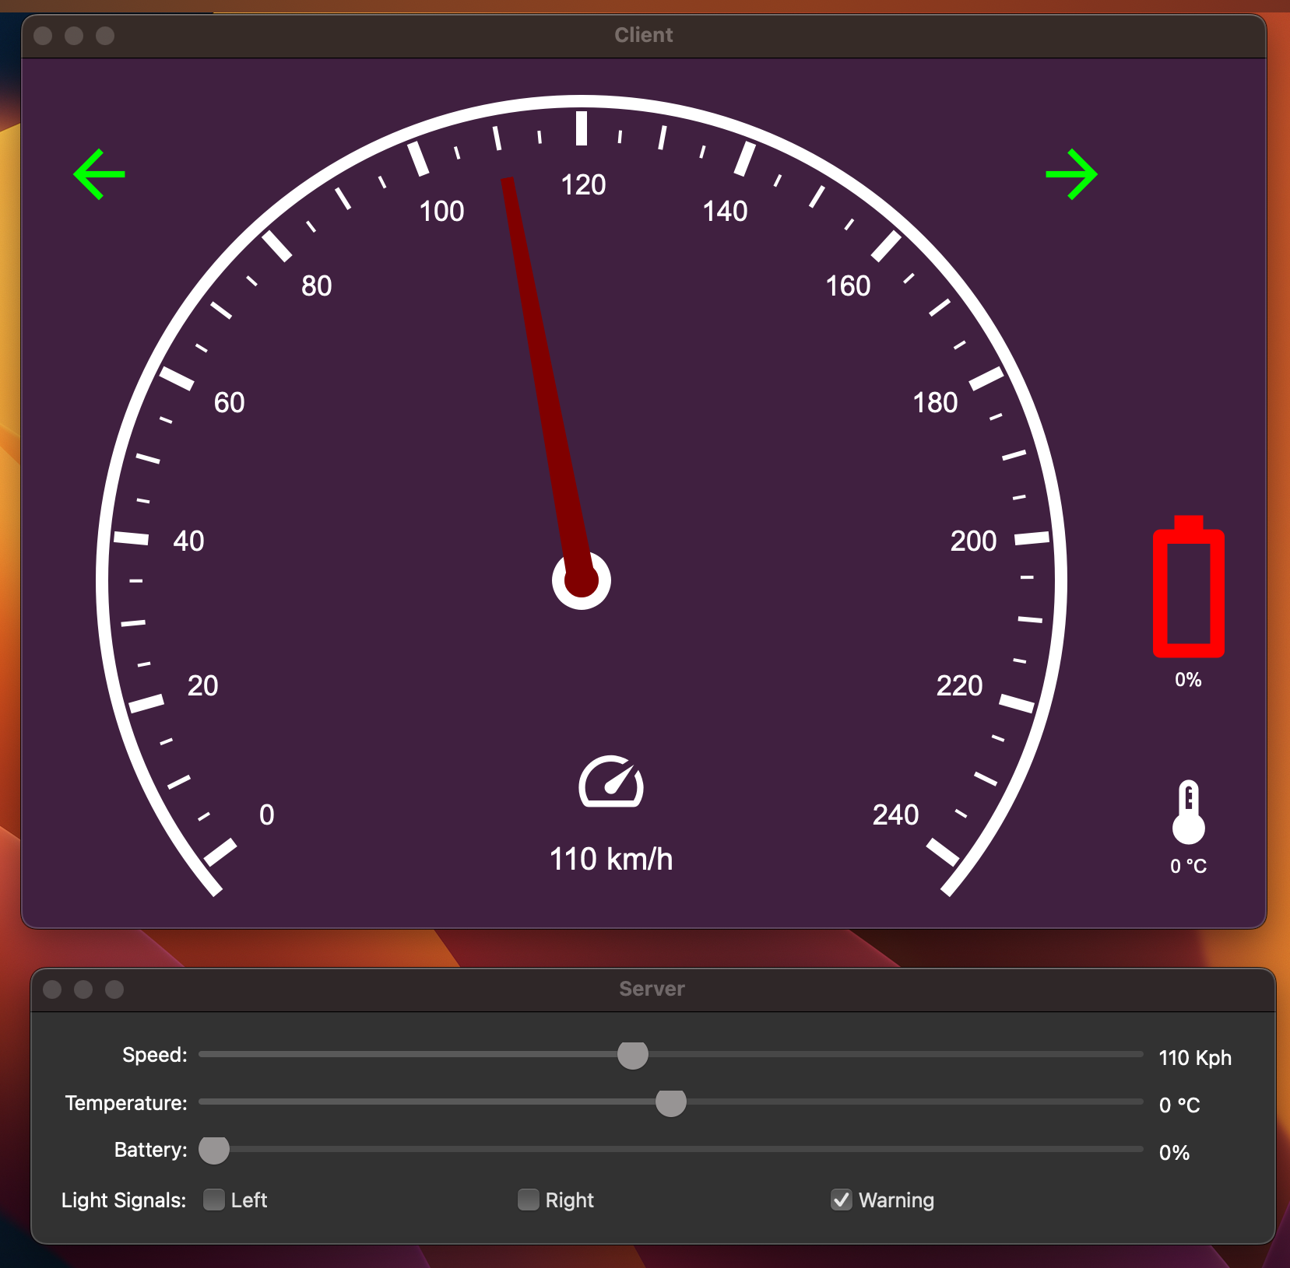
Project Overview
On the server GUI, there shall be:
A slider for speed. Speed is an integer in the range of 0 and 240.
A slider for temperature. Temperature is an integer in the range of -60 and 60
A slider for battery level. Battery level is an integer in the range of 0 and 100.
Three checkboxes for the light signals. When left is checked, right shall be disabled and
when right is checked, left shall be disabled. When warning is checked both the left.
right checkboxes shall be disabled. When none of the checkboxes is checked, all of them shall be enabled
On the client GUI there shall be:
simple dashboard to display speed, temperature, battery, level, light signals and status of the communication if there is a problem in the communication between client and server.
TCP/IP Communication is done via Internet protocol.
UART Serial Communication is done via Receiver and transmission port using wires and microcontrollers.

Slide 2

Tools and Technologies
Version control system = Git
This is used to track changes and collaborate on software development
Continuous Integration = GitHub
This is used to collaborate on git repositories
GUI design and sound implementation = Qt
This a cross platform application for developing graphical user interface.
Project configuration, Dependency management, Builds = CMake, VSC and Platformio
Cmake is used to manage build process for software projects.
VSC is a code editor used for code writing and debugging purposes.
Platformio is an open-source ecosystem for cross-platform development in embedded systems for easier project management for microcontrollers.

Slide 3
Project work (The way we worked)
Collaboration tools and platforms used (e.g., GitHub for version control).
Agile way of working i.e. Scrum.
Communication channels within the team was done through Slack and zoom.
Task allocation and responsibilities was done by the Scrum master.
Meeting schedules and progress tracking/Sprint review.
Notes:
- The way you worked

Slide 4
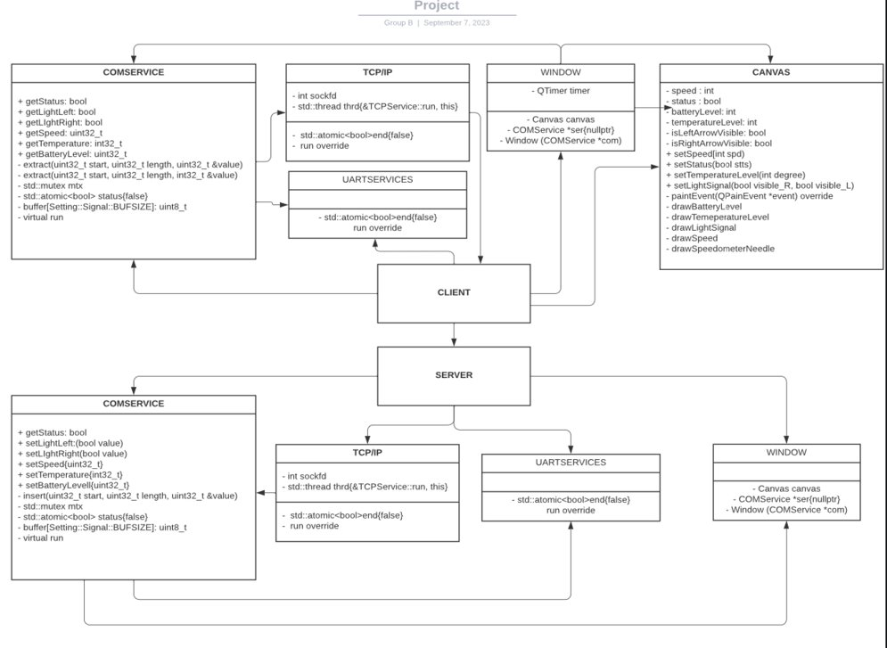
Project Architecture

Slide 5
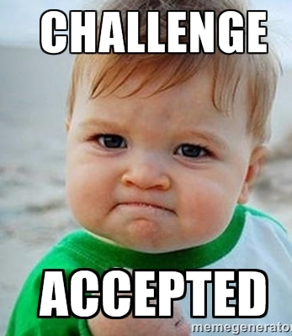
Challenges!!!
Technical challenges: members using different operating systems (e.g., Linux, Windows, macOS) presented compatibility issues like sound sync, GUI and Ports.
Testing complexities: especially when trying to make all functionalities work during CAN communication (supports multi master, message-based protocol)
Quality assurance: it was difficult maintaining consistent code quality and preventing regression due to frequent updates from various team member, so we implemented a form of continuous integration to avoid conflicts.
Learning Curve: Learning new tools, frameworks (like Qt), and some technologies during the project was time-intensive and it temporarily slowed down development.
Notes:
- In the context of software development, "regression" refers to the unintended reintroduction of a bug or defect that was previously identified and fixed in the software.

Slide 6
Demo

